Slide 1
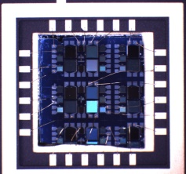
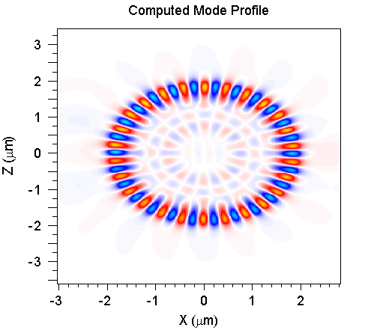
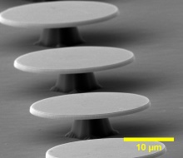
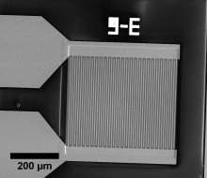
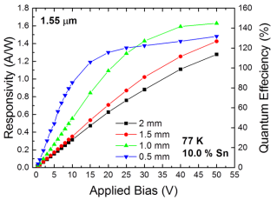
Development of GeSn Devices for Short Wave Infrared Optoelectronics
Student: Benjamin R. Conley Degree: Ph.D., December 2014
Major Professor: Dr. Fisher Yu
Microelectronics
Photonics
Background/Relevance
Current infrared imaging sensors are expensive and only available in small array formats.
Monolithic integrated laser on Si needed for high speed photonic communications to replace slower, copper based connections.
Innovation
Use GeSn material system using large scale Si CMOS processes to reduce costs and increase array density.
Design high optical gain cavity to demonstrate capacity for monolithic based Si laser.
Approach
Deposit epitaxial GeSn films using Ge buffer on Si substrates.
Fabricate photoconductors with coplanar and interdigitated contacts for increased gain and detector responsivity.
Model whisper gallery modes using FDTD software.
Fabricate microdisks with GeSn to measure optical gain and resonant optical modes.
Extract physical quantities through temperature dependent measurements.
Key Results
Measured key device parameters needed for new optoelectronic material system: lifetime, bandgap, activation energies, mobility.
Demonstrated high responsivity photoconductors in the short wave infrared (1.5 to 2.5 μ m).
Fabricated GeSn/Ge on Si microdisk resonators with enhanced whisper gallery photoluminescence.
Conclusions
GeSn photoconductors with responsivities greater than commercially available InGaAs photodiodes at 1.55 μm demonstrate viability as next generation technology.
Direct bandgap GeSn and smoother sidewalls required for stimulus emission microdisks.
Increasing Sn content extends spectral response to longer wavelengths without sacrifice in material quality or responsivity.
Future Work
Improve etching and passivation of GeSn devices.
GeSn avalanche photodiodes should be further investigated.
GeSn 2D focal plane array on Si should be investigated.
Place funding acknowledgment here if applicable (can use text and/or logo)

