Slide 1
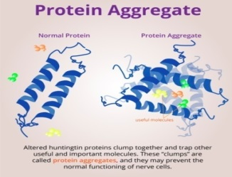
Characterization of Protein Aggregation by Solid State Nanopore
Student: Mitu Chandra Acharjee Degree: Ph.D., August 2020
Major Professor: Dr. Jiali Li
Biological Materials & Devices
Nanoengineered Materials & Devices
Background/Relevance
Many neurodegenerative diseases like Alzheimer, Parkinson and Prion are found to be linked to protein aggregation. Existing protein characterization methods are:
Not easily available.
Expensive.
Low precision rate.
Innovation
Build a new system that can be used to:
1- Characterize protein aggregation.
2- Low cost and high precision.
3- Easily moveable/reduced size.
Approach
Proteins translocate through a single nanopore in a Si₃N₄ membrane that separates two salt solution-filled chambers whose only connection was via the electrolyte (KCl) solution inside the nanopore.
Protein molecules translocating through a nanopore partially block the ion flow and the current blockage pulse or event can be measured.
By measuring the current and using nanopore geometry the translocated protein and its aggregations can be characterized.
Ross, CA., Poirier, MA., Protein aggregation and neurodegenarive disease. Nat. Med., 2004. 10: p. S10-S17
Key Results
Solid-state nanopore (6-30 nm) has been fabricated and imaged using TEM.
The aggregation of β-lactoglobulin in ionic solution is measured using solid-state nanopore, the results are verified using dynamic light scattering technique.
The aggregation of Tau-Tubulin is induced using MgCl₂ in vitro. The aggregated proteins were detected using ~30 nm nanopore in 1.6 M KCl solution. 20% glycerol was used in KCl solution to increase viscosity and translocation time.
Conclusions
This work supports the understanding of the theory and principle of:
Characterizing protein aggregation through measuring blockage current in the ionic solution.
Aggregation of proteins as a function of temperature, pH, salt concentration and applied voltages.
Future Work
Future work will be to understand how proteins aggregate and look for a solution to stop their aggregation which contribute to the cure of many diseases caused by protein aggregation.
This research is supported by Arkansas Bioscience Institute (ABI), grants no. 040227504-21-0292, 015227504-23-0292, 011225311-22-0000.

